Slide 1
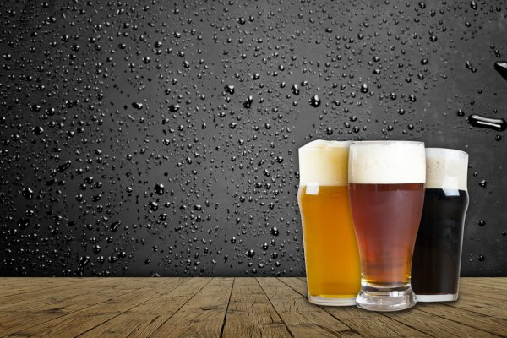
What would you like to drink today?
Predictive Pandas presents
Michelle Hocking
Eamonn McCallum
Pooja Mallard
Ruohong Yuan
Yann Chye
Katherine Shamai

Slide 2


Getting back on the beers
Now that Victorians can “get on the beers” again, what to drink?
You can go the same old, same old but you’re probably tired of that since that’s all you’ve been drinking for the past 6 months
We thought it would be great to celebrate the world of craft beers and get Victorians to try something different and find a new favorite
Using review data and data on breweries, we set out on a virtual brewery crawl to find good datasets to teach a computer how to appreciate a good craft beer

Slide 3

Data search
From our search, we identified 2 data sets
Data set 1 – []
Data set 2 – []

Slide 4
Data Munging
ETL
ML
Training the model
Visualisation
Publication

Slide 5
ETL
Cleansing of data included adding feature for each unique beer and grouping reviews by beer
Count of review and understanding the standard deviation to determine the reliability and variability of the reviews

Slide 6
Scraping for brewery data

Slide 7
Machine Learning

Slide 8
Training the model

Slide 9
Visualisation

Slide 10
Streamlit

Slide 11
Interesting observations

Slide 12
Challenges

Slide 13
If I had my time again

Slide 14
Other features we would add

Slide 15
Demo

